Slide 1
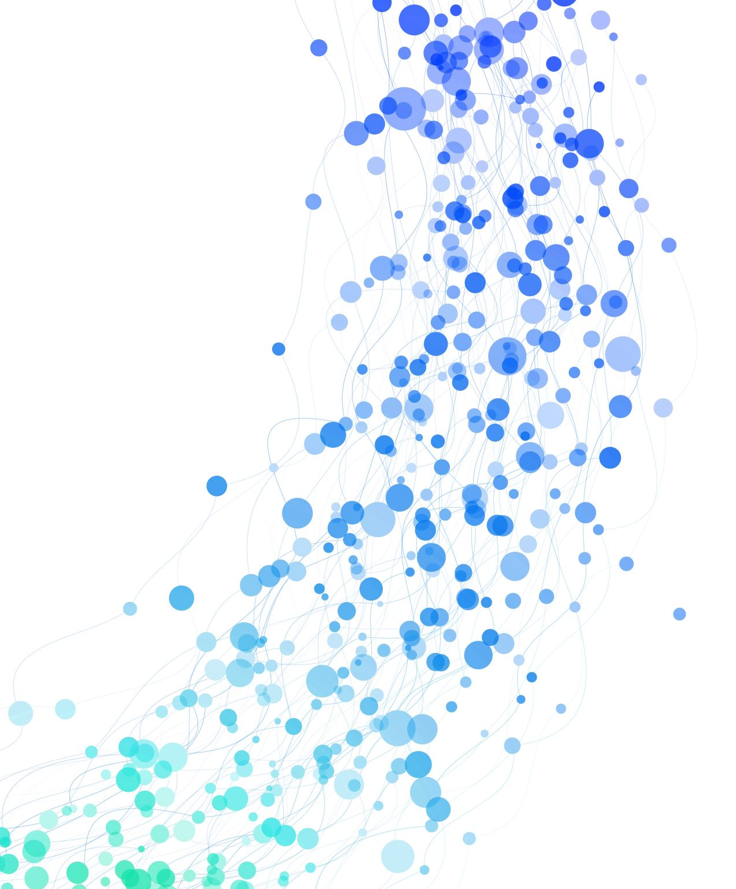
Ridge Regression

Slide 2
What is Linear Regression?
Linear Regression is a supervised machine learning algorithm used to predict a continuous value based on one or more independent features.
It finds the best-fit line through the data.
Equation: Y = β₀ + β₁X₁ + β₂X₂ + ... + βₙXₙ
Y: The target variable (the value we want to predict) β₀: Intercept (constant term) → The expected value of Y when all X = 0 → It's where the line crosses the Y-axis
β₁, β₂, ..., βₙ: Coefficients (slopes) of the independent variables
Goal: Minimize the Mean Squared Error (MSE).

Slide 3
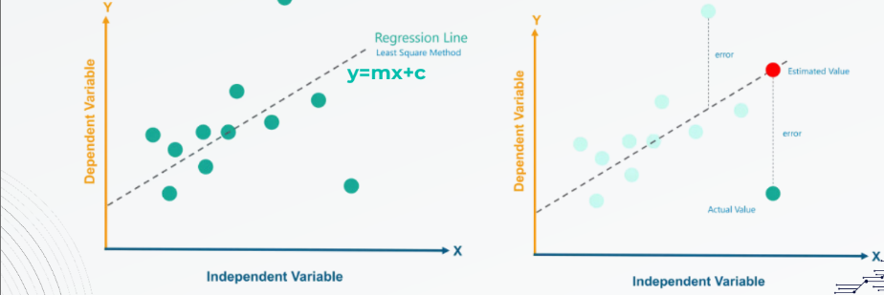
Linear regression shows the relationship between an independent variable (X) and a dependent variable (Y) using a straight line (regression line). The line is fitted using the least squares method, aiming to minimize the distance (errors) between the actual data points and the line. Errors are the differences between the actual values and the predicted values from the regression line, and the model seeks to reduce these errors

Slide 4

EVALUATION METRICS
In linear regression, the evaluation of a model's performance is typically done using different
metrics to quantify how well the model fits the data. Some common evaluation metrics are:
1. Mean Squared Error (MSE)
Formula:
Explanation: This measures the average squared difference between actual values and predicted values.
A lower MSE indicates a better fit.

Slide 5
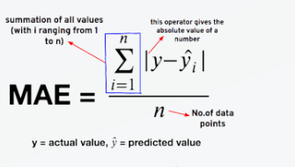
EVALUATION METRICS
2. Root Mean Squared Error (RMSE)
Explanation: RMSE is simply the square root of MSE, providing error values in the same unit as the
output . It gives a clearer sense of the error magnitude.
3. Mean Absolute Error (MAE)
Formula:
Explanation: This measures the proportion of the variance in the dependent variable that is predictable
from the independent variable(s). values range from 0 to 1, where 1 indicates a perfect fit.

Slide 6

EVALUATION METRICS
4.R-squared (R2)
Formula:
Explanation: This measures the proportion of the variance in the dependent variable that is predictable
from the independent variable(s). values range from 0 to 1, where 1 indicates a perfect fit.

Slide 7
IMPROVE A MODEL
There are two main methods to improve a model, one of which relies on Gradient Descent, while the
other involves alternative techniques for enhancing performance. Here’s a breakdown of each method:
1. Gradient Descent:
Gradient Descent is an optimization algorithm used to find the optimal values of parameters in
predictive models, like linear regression.
The goal is to minimize the cost function (which measures the difference between actual and predicted
values by the model).
The model parameters (( m ) and ( c ) in the equation ( y = mx + c )) are updated iteratively by following
the gradient (slope) of the cost function:

Slide 8
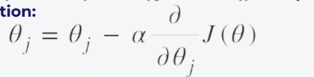
the gradient (slope) of the cost function:
where:
- ( theta) represents the parameters (like the slope \( m \) and intercept \( c \)).
- ( alpha) is the learning rate.
- ( J(theta)) is the cost function (Mean Squared Error - MSE).
With each step of Gradient Descent , the algorithm moves closer to the optimal solution by
continuously reducing the error until it reaches a point where the slope is zero, indicating a minimum
error.

Slide 9
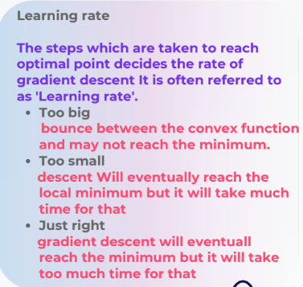
How to improve the model using Gradient Descent?
Choosing the right learning rate: A learning rate that is too high may cause the algorithm to
overshoot the optimal solution, while a rate too low can make the process too slow.
Adjusting the number of iterations: This determines how many steps the algorithm takes to update
the parameters. More iterations can lead to a more refined solution but may take longer to converge.

Slide 10
IMPROVE A MODEL
Other Techniques for Improvement:
1.Regularization:
Techniques like Lasso (L1) and Ridge (L2) regularization can help reduce model complexity. These methods add a
penalty to large coefficients, preventing the model from overfitting.
Lasso tends to make some coefficients exactly zero, effectively selecting only the most important features.

Slide 11
IMPROVE A MODEL
-Ridge reduces the magnitude of all coefficients but doesn’t zero them out.
2.Increasing Data Size:
Increasing the amount of data used for training can improve model accuracy and reduce the likelihood of
overfitting. The more data the model has, the better it can generalize patterns.
3.Cross-Validation:
Utilizing cross-validation to assess model performance across different subsets of data provides a more accurate
estimate of the model’s generalization ability and helps reduce overfitting on the training data.

Slide 12
Overfitting and the Need for Regularization
Overfitting: Model performs well on training data but poorly on test data.
Caused by complex models or multicollinearity.
Regularization adds a penalty to reduce coefficient sizes and prevent overfitting.

Slide 13
Introduction to Ridge Regression
Ridge regression is a regularized linear regression model that adds an L2 penalty to prevent overfitting, ideal for datasets with multicollinearity.
Key Features:
Shrinks coefficients to reduce variance
Uses hyperparameter λ (alpha in scikit-learn) to control regularization
Suitable for high-dimensional datasets like Ames Housing
Visual: Diagram comparing linear vs. ridge regression (coefficient shrinkage)

Slide 14
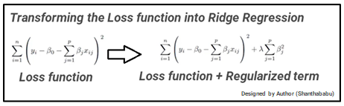
Ridge Regression Loss Function
MSE Term: This is the usual loss used in Linear Regression. It measures how far our predictions are from the true values.
βj\beta_jβj​: These are the model's coefficients (or weights) for each feature.
L2 Penalty: This is the sum of the squares of the coefficients
( n ): Number of data points
( \lambda ):α\alphaα: A parameter that controls how much we penalize large coefficients. It’s also called the regularization strength.
Ridge Regression is like Linear Regression, but it adds a penalty term to avoid overfitting. It minimizes both the prediction error (MSE) and the size of the model's coefficients using this loss function.(When alpha = 0, it becomes normal Linear Regression.)

Slide 15
from sklearn.linear_model import Ridge
from sklearn.metrics import mean_squared_error
import numpy as np
# Create and train model
ridge_model = Ridge(alpha=10)
ridge_model.fit(X_train, y_train)
# Make predictions
y_pred = ridge_model.predict(X_test)
# Evaluate model
mse = mean_squared_error(y_test, y_pred)
print("Mean Squared Error:", mse)
# Show coefficients
print("Coefficients:", ridge_model.coef_)

Slide 16
Cross-Validation to Choose Best Alpha
Why Use Cross-Validation?
Different alpha values change the model’s complexity.
Cross-validation helps us find the alpha that gives best generalization performance.
Prevents overfitting or underfitting.
How It Works:
Try multiple values of alpha (e.g., 0.01, 0.1, 1, 10, 100).
For each alpha:
Train on part of data
Test on validation set
Record performance (e.g., MSE or accuracy)
Choose the alpha with lowest validation error

Slide 17
Automatic Cross-Validation for Ridge)
from sklearn.linear_model import RidgeCV
# Try different alpha values
alphas = [0.01, 0.1, 1, 10, 100]
# Perform cross-validation internally
ridge_cv = RidgeCV(alphas=alphas, cv=5)
ridge_cv.fit(X_train, y_train)
# Best alpha found
print("Best alpha:", ridge_cv.alpha_)

Slide 18
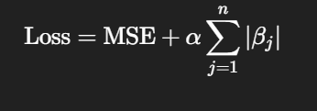
What is Lasso Regression?
Another regularization technique (L1 regularization).
Adds penalty on the absolute values of coefficients.
Can shrink some coefficients to zero, performing feature selection.
Loss Function
MSE = Mean Squared Error
α = Regularization strength
β_j = Model coefficients
As α increases, more coefficients are shrunk toward 0

